Slide 1
HTML - Backgrounds

Slide 2
Html Background with Colors
The bgcolor attribute is used to control the background of an HTML element, specifically page body and table backgrounds.
<body>
<!-- Format 1 - Use color name -->
<table bgcolor = "yellow" width = "100%">
<tr> <td> This background is yellow </td> </tr>
</table>
<!-- Format 2 - Use hex value -->
<table bgcolor = "#6666FF" width = "100%">
<tr> <td> This background is sky blue </td> </tr>
</table></body>

Slide 3
Html Background with Images
The background attribute can also be used to control the background of an HTML element, specifically page body and table backgrounds. You can specify an image to set background of your HTML page or table.
<body>
<!-- Set table background -->
<table background = "/images/html.gif" width = "100%" height = "100">
<tr><td> This background is filled up with HTML image. </td></tr> </table>
</body>

Slide 4
HTML - Fonts

Slide 5
Fonts play a very important role in making a website more user friendly and increasing content readability. Font face and color depends entirely on the computer and browser that is being used to view your page but you can use HTML <font> tag to add style, size, and color to the text on your website.
The font tag is having three attributes called size, color, and face to customize your fonts.
Set Font Size
You can set content font size using size attribute. The range of accepted values is from 1(smallest) to 7(largest). The default size of a font is 3.

Slide 6
<body>
<font size = "1">Font size = "1"</font><br />
<font size = "2">Font size = "2"</font><br />
<font size = "3">Font size = "3"</font><br />
<font size = "4">Font size = "4"</font><br />
<font size = "5">Font size = "5"</font><br />
<font size = "6">Font size = "6"</font><br />
<font size = "7">Font size = "7"</font>
</body>

Slide 7
Setting Font Face
You can set font face using face attribute
<body>
<font face = "Times New Roman" size = "5">Times New Roman</font><br />
<font face = "Verdana" size = "5">Verdana</font><br />
<font face = "Comic sans MS" size =" 5">Comic Sans MS</font><br />
<font face = "WildWest" size = "5">WildWest</font><br />
<font face = "Bedrock" size = "5">Bedrock</font><br />
</body>

Slide 8
Setting Font Color
You can set any font color you like using color attribute. You can specify the color that you want by either the color name or hexadecimal code for that color.
<body>
<font color = "#FF00FF">This text is in pink</font><br />
<font color = "red">This text is red</font>
</body>

Slide 9
HTML - Iframes
You can define an inline frame with HTML tag <iframe>. The <iframe> tag is not somehow related to <frameset> tag, instead, it can appear anywhere in your document. The <iframe> tag defines a rectangular region within the document in which the browser can display a separate document, including scrollbars and borders. An inline frame is used to embed another document within the current HTML document.
The src attribute is used to specify the URL of the document that occupies the inline frame.

Slide 10
<body>
<p>Document content goes here...</p>
<iframe src = "/html/menu.htm" width = "555" height = "200">
Sorry your browser does not support inline frames.
</iframe>
<p>Document content also go here...</p>
</body>

Slide 11
The <Iframe> Tag Attributes
Most of the attributes of the <iframe> tag, including name, class, frameborder, id, longdesc, marginheight, marginwidth, name, scrolling, style, and title behave exactly like the corresponding attributes for the <frame> tag.

Slide 12
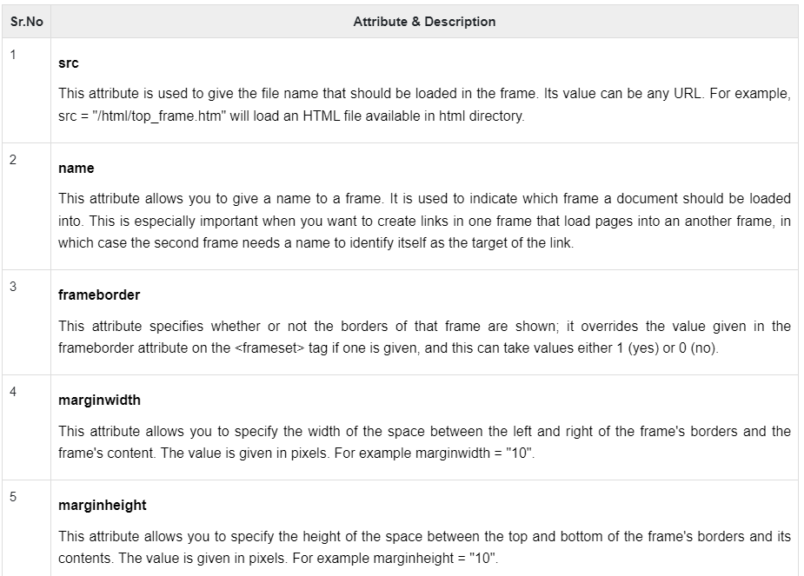

Slide 13
